Slide 1
Developing an end to end pipe line implementation for Thyroid Disease Detection
VAYUGUNDLA DHRUV
ABHIRAM REDDY BAVIKADI
LALITHA CHARAN
DURGA SREEJA
PENUGONDA VENKATA NAGA SIVAMANI
G.PAVITRA

Slide 2
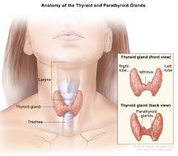
What is thyroid?
Thyroid disorders encompass conditions like hypothyroidism (underactive thyroid) and hyperthyroidism (overactive thyroid). Symptoms vary but may include fatigue, weight changes, mood swings, and difficulty regulating body temperature. Diagnosis involves blood tests measuring thyroid hormone levels. Treatment often involves medication, lifestyle changes, or in severe cases, surgery. Thyroid disorders are manageable with proper medical care but require ongoing monitoring.

Slide 3
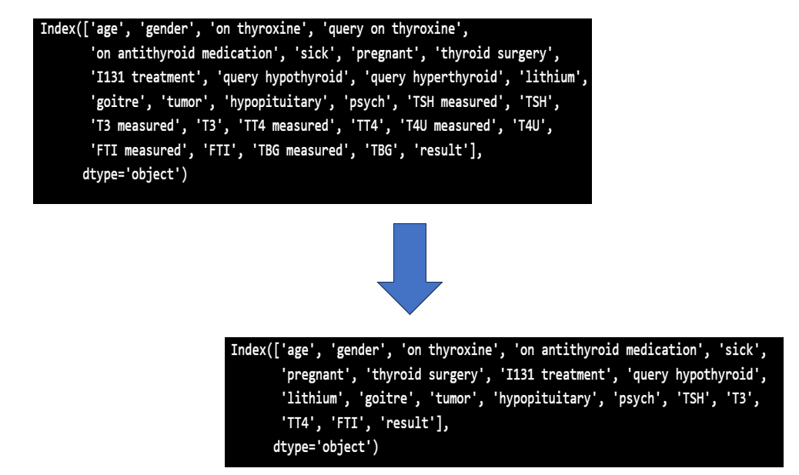
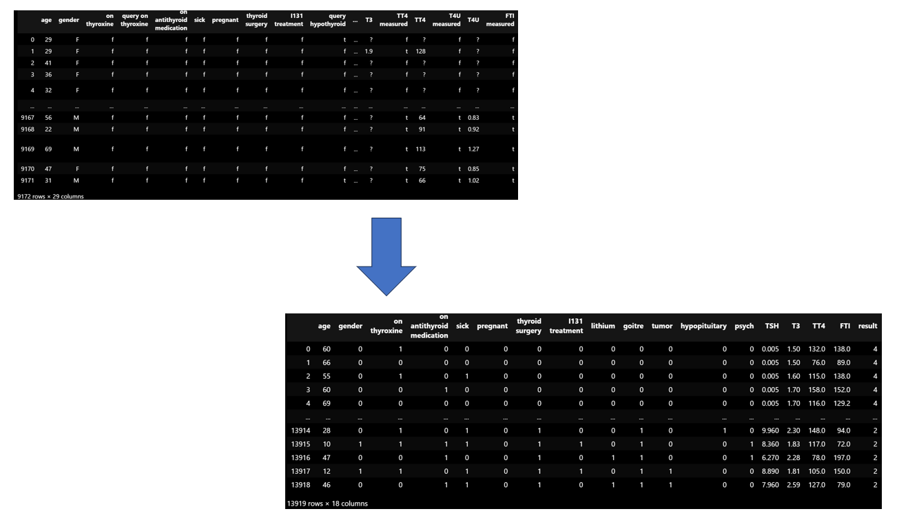
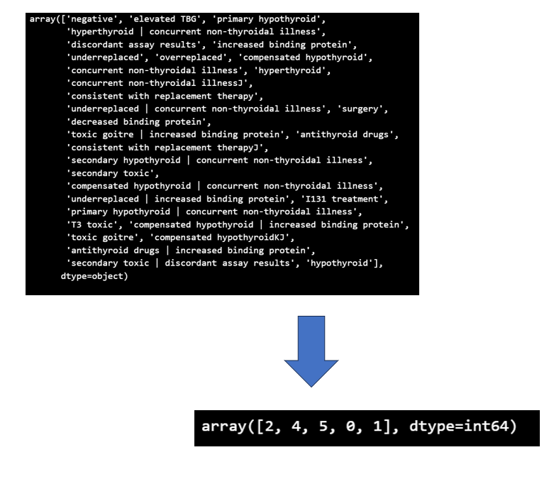
EDA (Elementary Data Analysis)

Slide 4
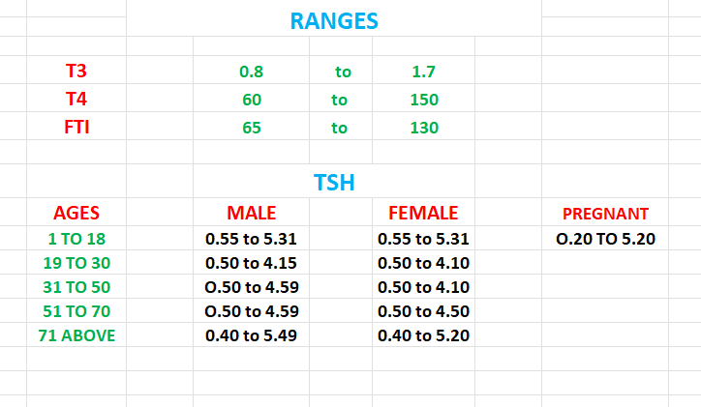
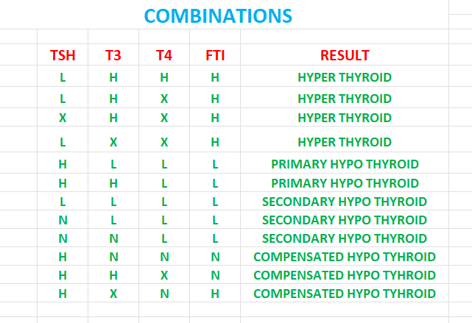
Analysis results

Slide 5
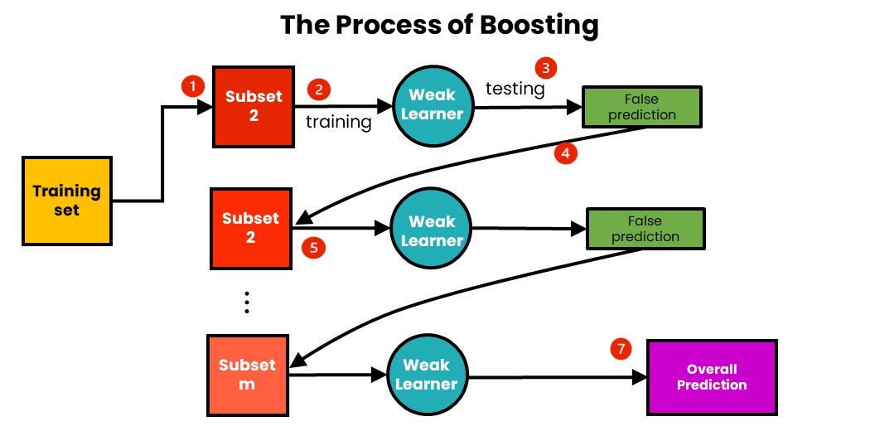
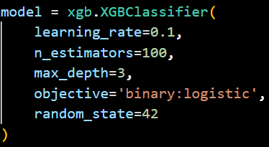
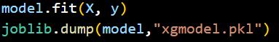
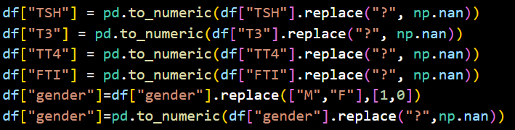
Model building

Slide 6
Others
First login only
Compulsory details
Main page
Login
Normal
Start
Diet
Workout
Test
Profile
Signup
Normal
OTP verification
Update Profile
Others
No Medical Details
Medical Details
Forgot
General Analysis
Result
User Confirm
OTP verification
Learn More
Reset password

Slide 7
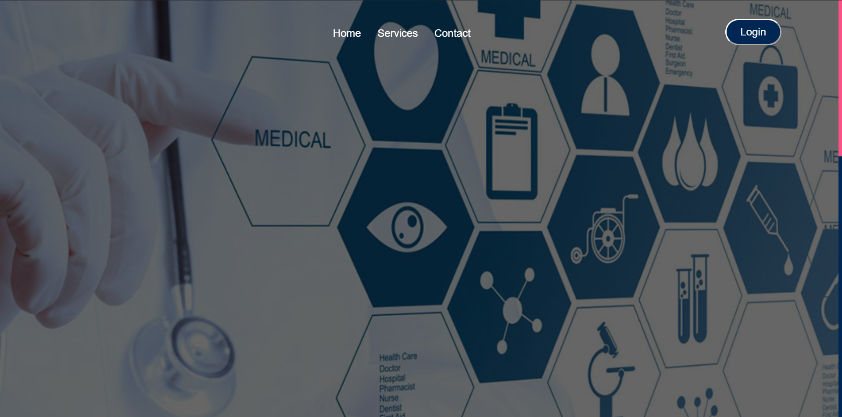
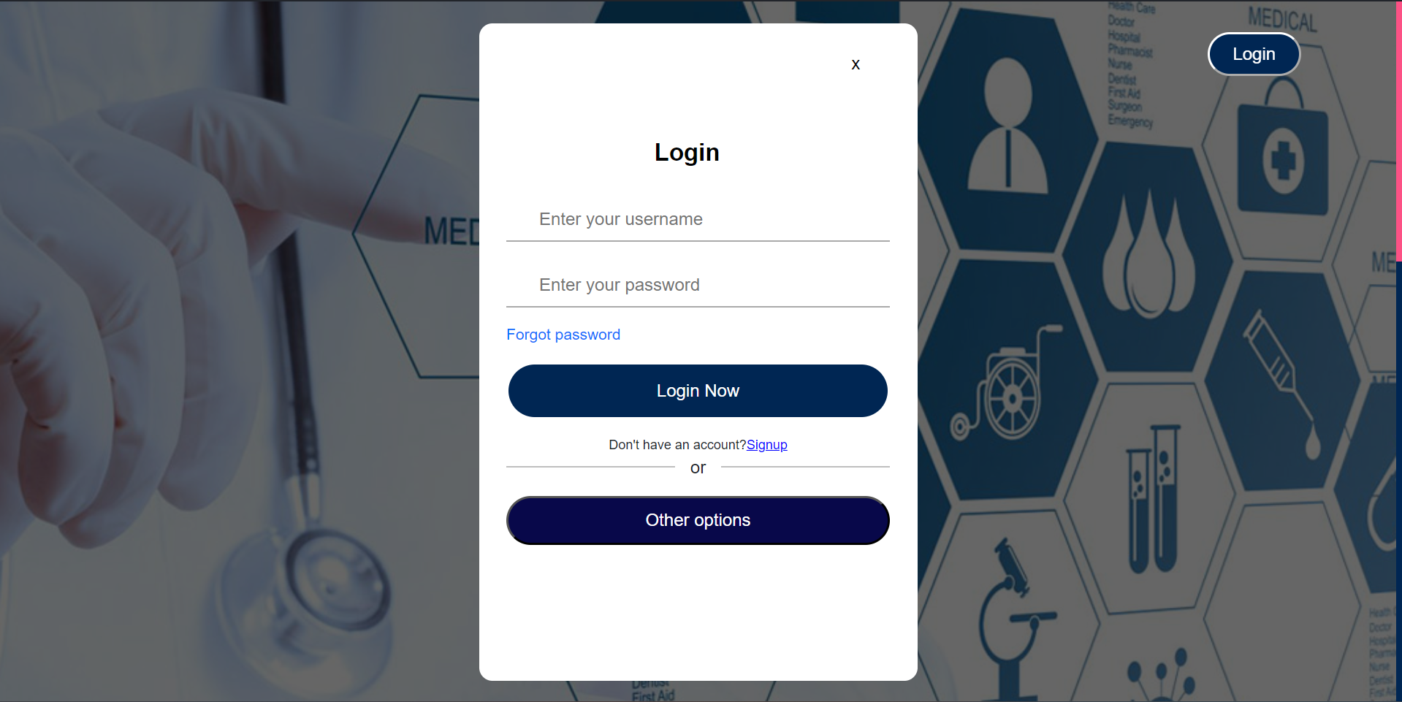
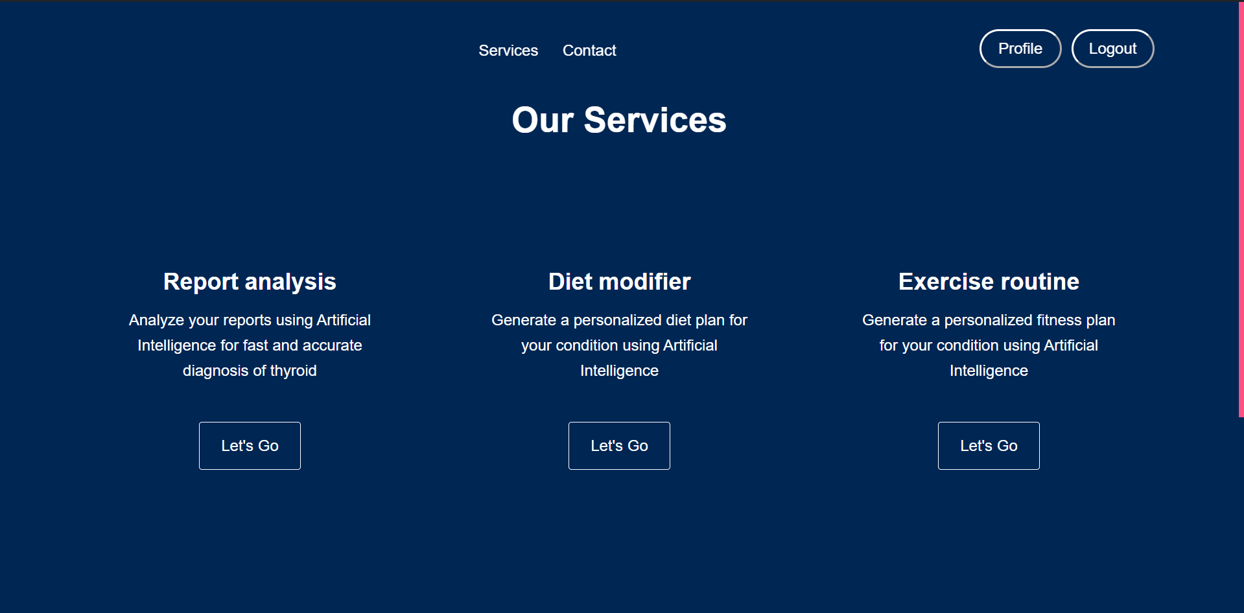
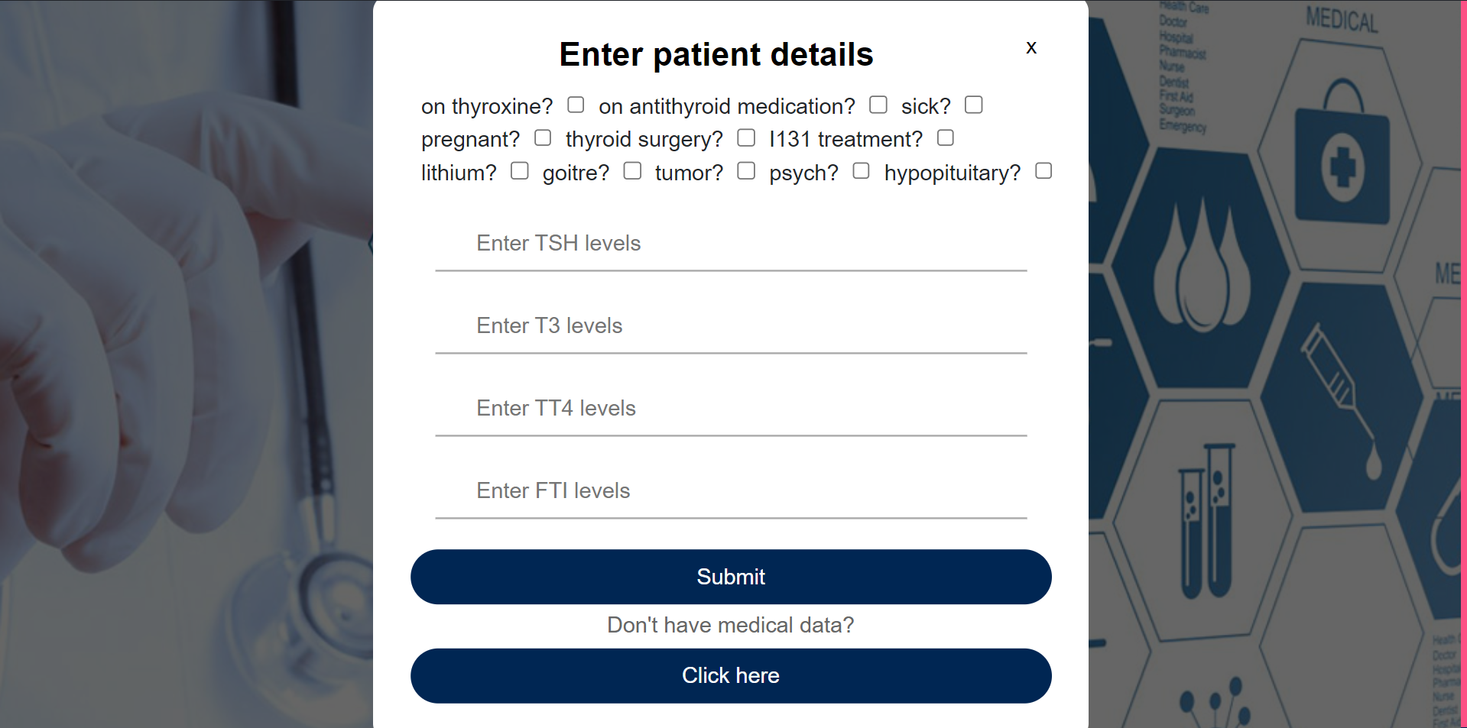
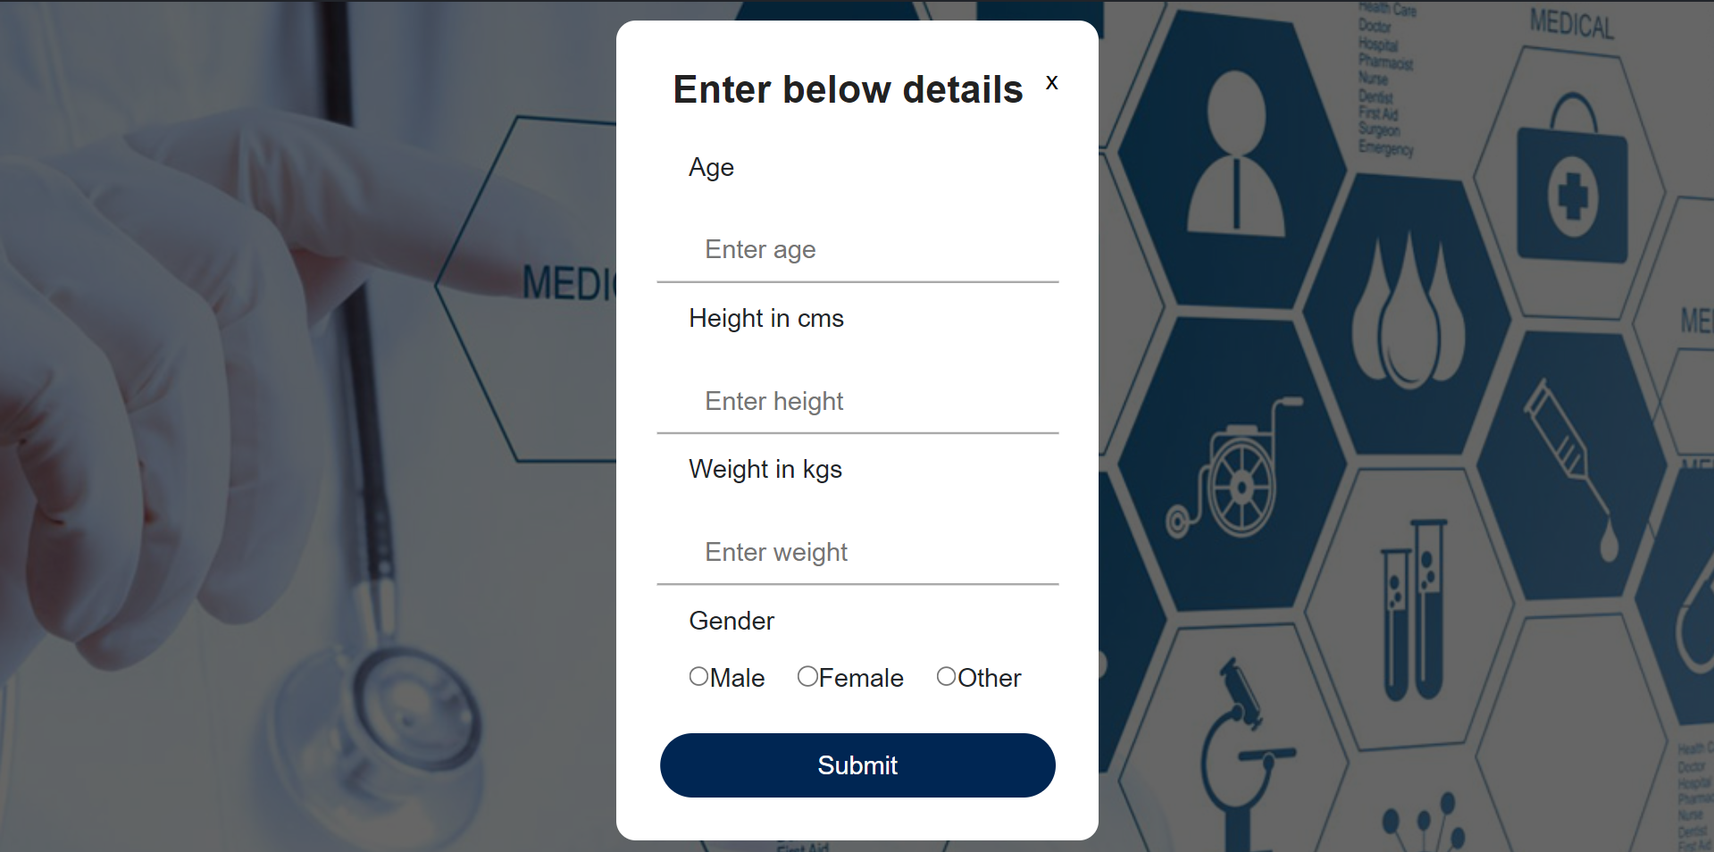
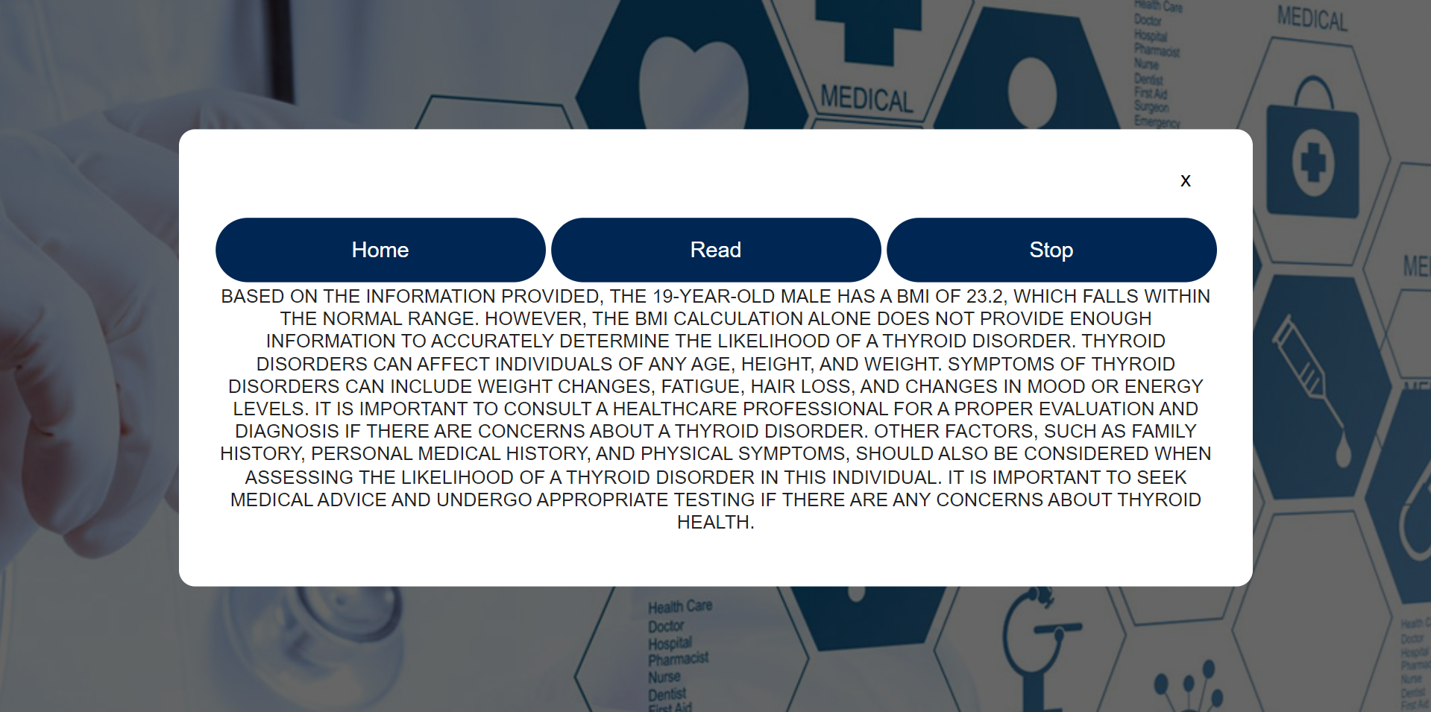
Front end

Slide 8
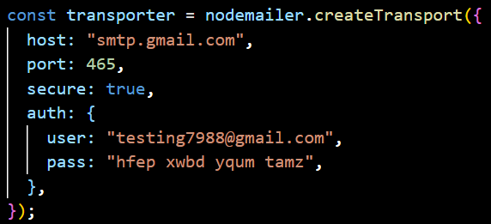
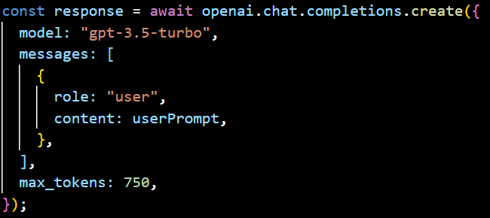
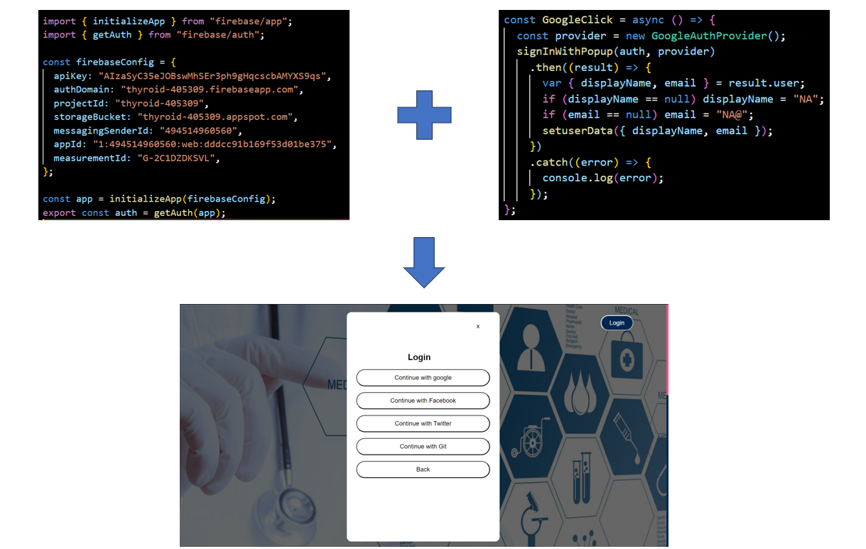
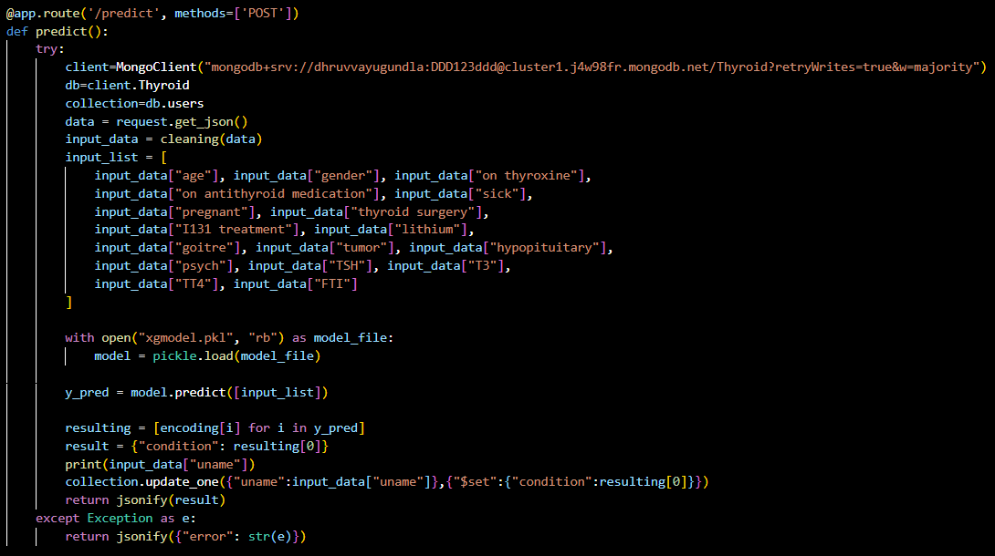
Backend

